Slide 1
UNIT 3

Slide 2
We have discussed on:
Budget line
Consumers preference
Optimal choice

Slide 3
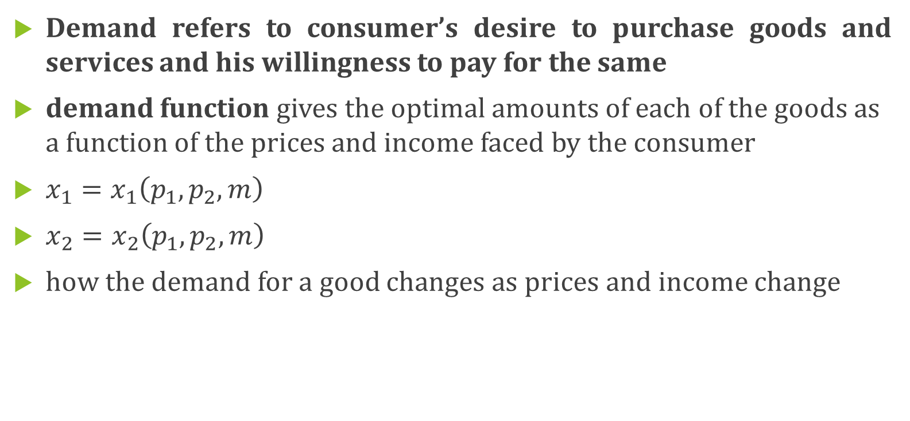
The demand function
Demand refers to consumer’s desire to purchase goods and services and his willingness to pay for the same
demand function gives the optimal amounts of each of the goods as a function of the prices and income faced by the consumer
$x_{1}=x_{1}\left(p_{1},p_{2},m\right)$
$x_{2}=x_{2}\left(p_{1},p_{2},m\right)$
how the demand for a good changes as prices and income change

Slide 4
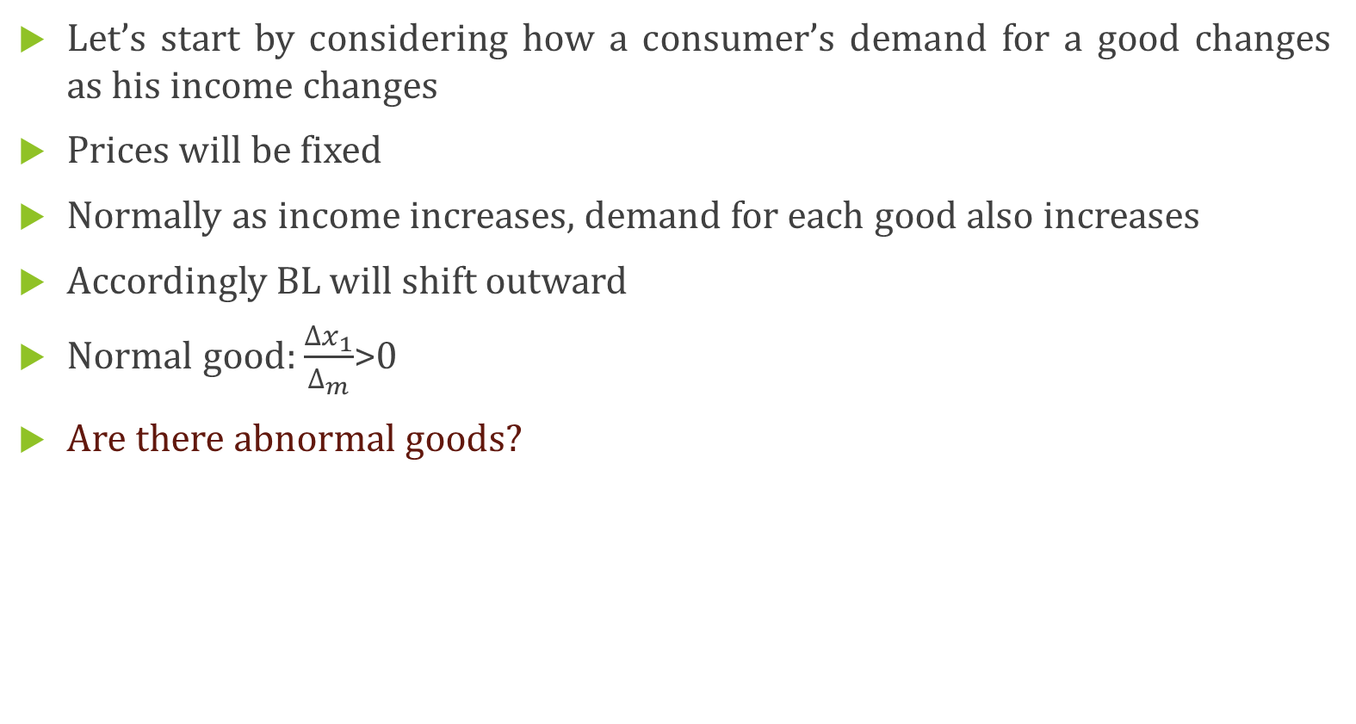
Normal and Inferior good
Let’s start by considering how a consumer’s demand for a good changes as his income changes
Prices will be fixed
Normally as income increases, demand for each good also increases
Accordingly BL will shift outward
Normal good: $\frac{{∆x}_{1}}{∆_{m}}$>0
Are there abnormal goods?

Slide 5
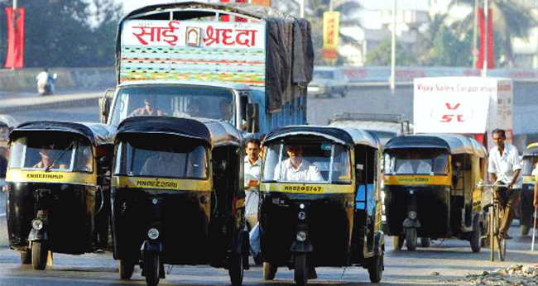
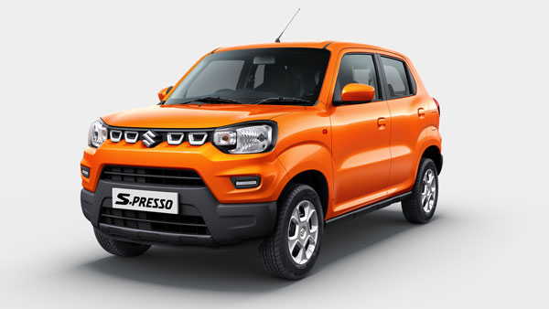

Slide 6

An increase of income results in a reduction in the consumption of one of the goods
Inferior good: $\frac{{∆x}_{1}}{∆_{m}}<$0

Slide 7






Income offer curve and Engel curves
Income offer curve
$$x_{2}^{ii}$$
$$x_{2}^{i}$$
$$x_{2}$$
$$x_{1}$$
$$x_{1}^{ii}$$
$$x_{1}^{i}$$

Slide 8
Income offer curve is also known as income expansion path
Will be having a positive slope if both goods are normal good

Slide 9

Engel curve
$x_{i}=x_{1}\left(p_{i},p_{2},m\right)$: Guess what?
Then
$x_{i}=x_{1}\left(p_{1},p_{2},m_{i}\right)$: what is this?

Slide 10







$x_{1}$
$$m_{3}$$
$$m_{2}$$
$$m_{1}$$
$$x_{1}$$
$$x_{1}^{i}$$
$$x_{1}^{ii}$$

Slide 11
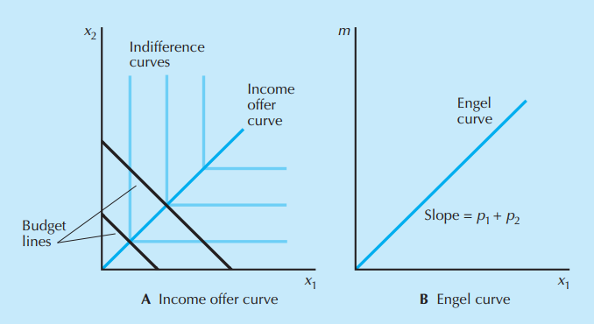
Example: perfect complement

Slide 12

Since the consumer will always consume the same amount of each good, no matter what, the income offer curve is the diagonal line through the origin.
Since the demand for good 1 is→ $x_{1}=\frac{m}{p_{1}+p_{2}}$

